Slide 1
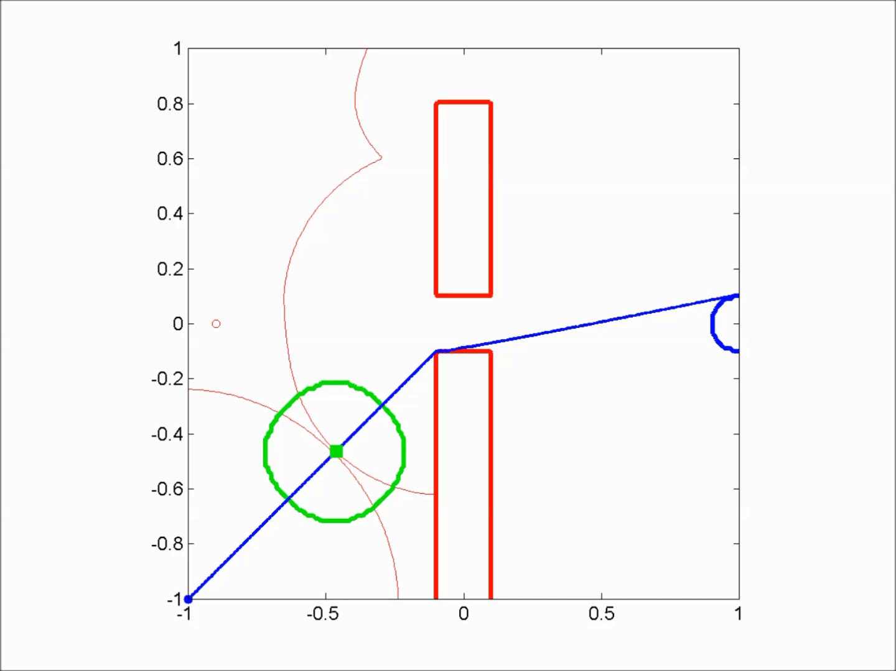
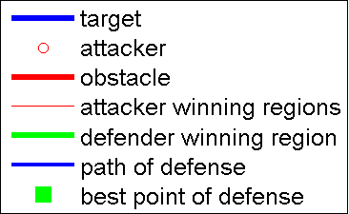
200 by 200 grid

Slide 2
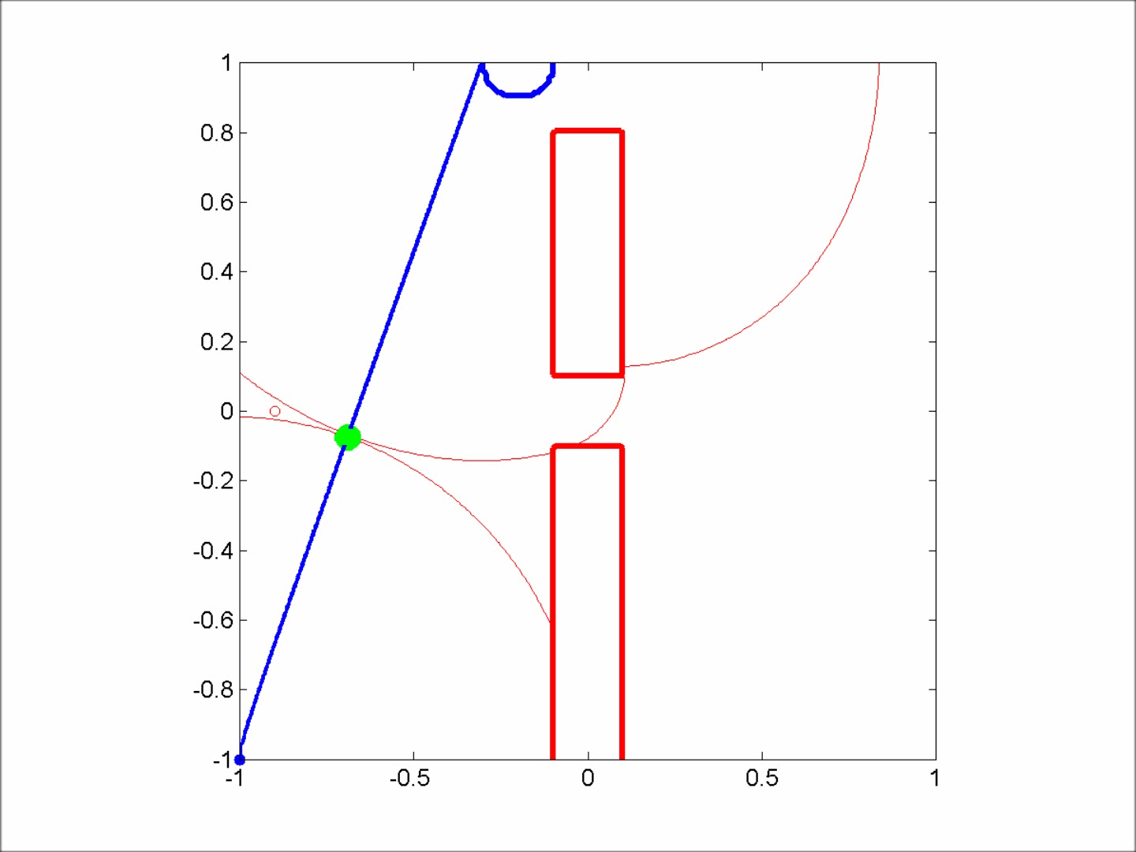
200 by 200 grid

Slide 3
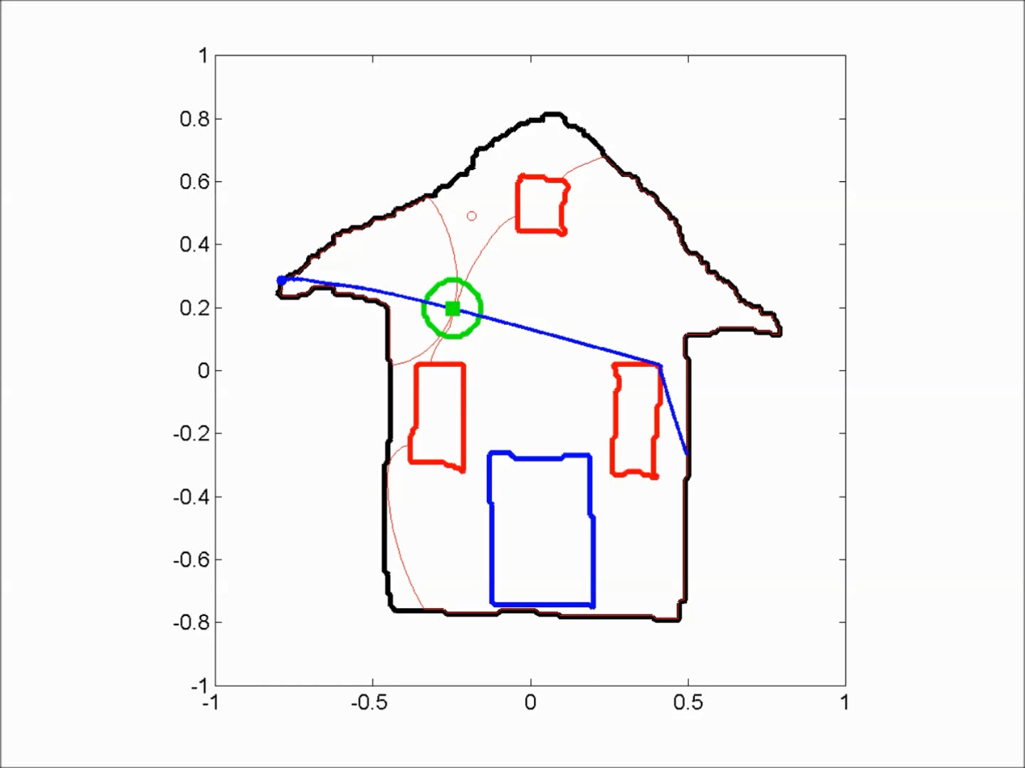
200 by 200 grid

Slide 4
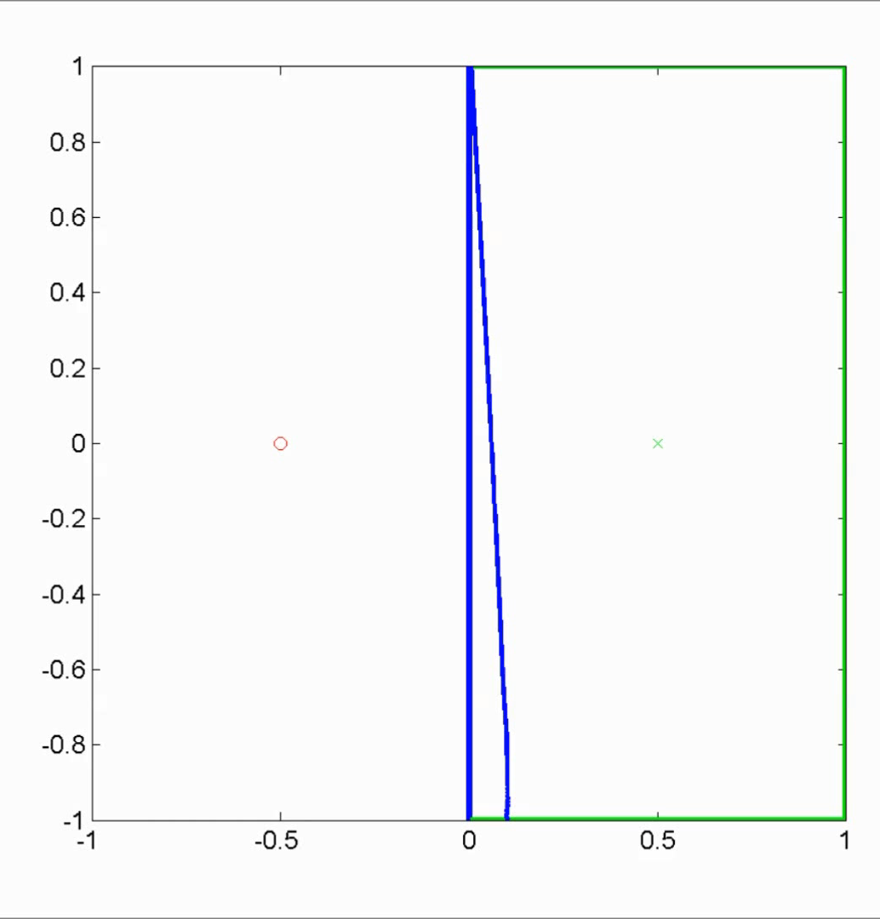
200 by 200 grid
83.4% of voronoi area is defendable

Slide 5
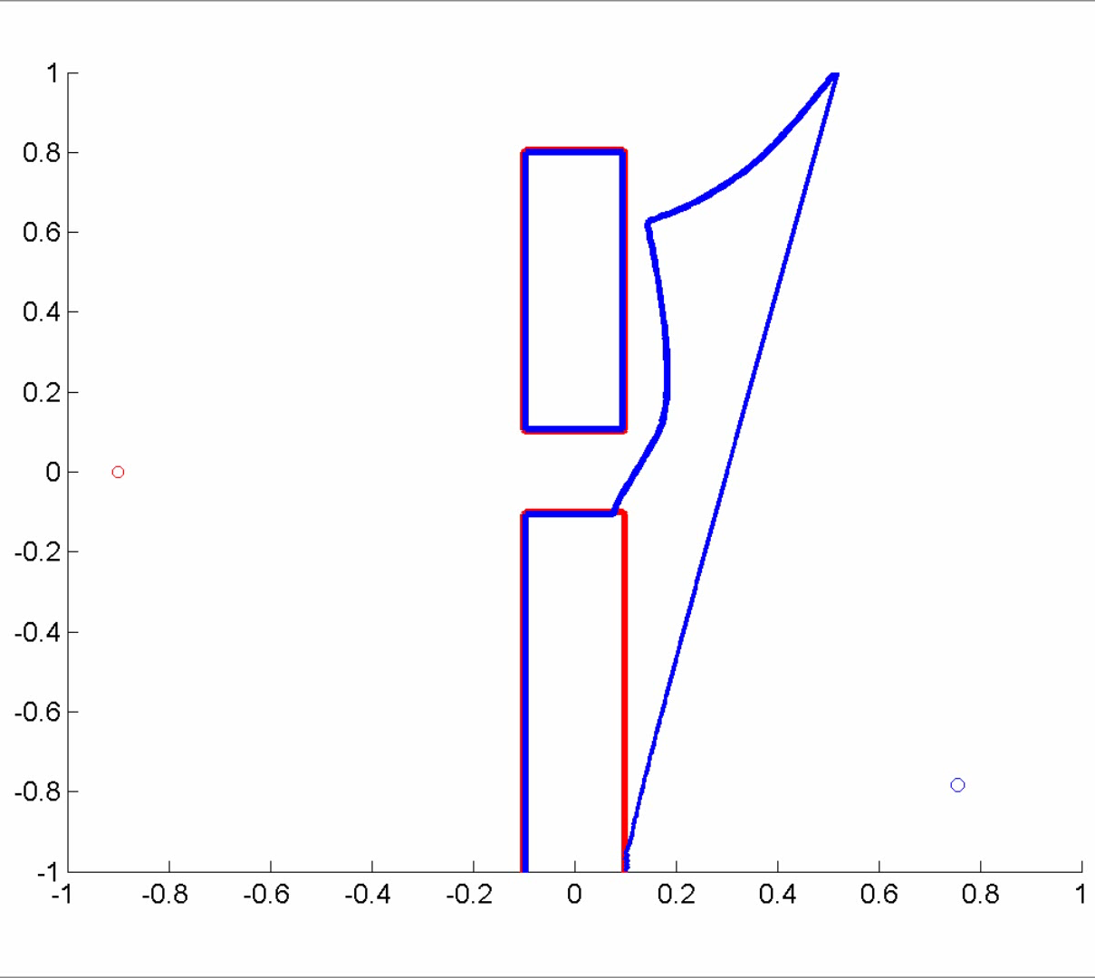
200 by 200 grid
79.3% of voronoi area is defendable

Slide 6
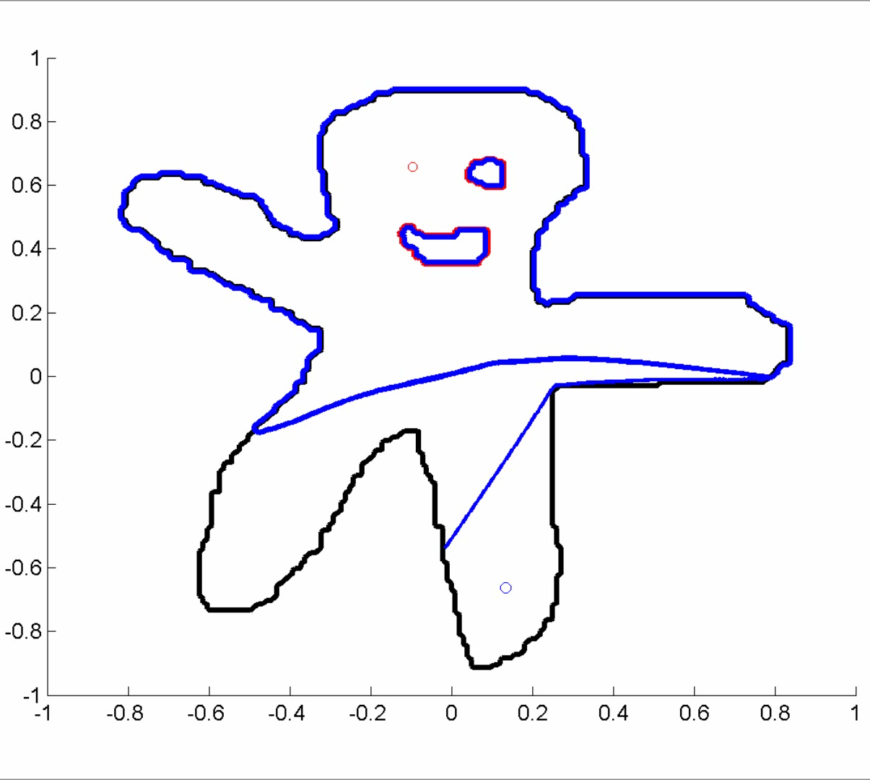
200 by 200 grid
83.2% of voronoi area is defendable

